Slide 1
Flooded Area Detector
Group Members:
Siddi Sujith (15241A05T1)
Nallana Harish (16245A0546) Internal Guide:
Shashi Preetham G (15241A05P9) Dr. Ch. Mallikarjuna Rao
Naveen Naik (16245A0552) (Professor of CSE department)

Slide 2
Contents:
Objective of the project.
1
Dataflow of the project.
2
Implementation of the project.
3

Slide 3
Objective of the project:
To provide service to various organizations which can use drones for capturing images during floods. The application provides image classification for the images captured.
01
This helps for effective management when floods occur. Continuous surveillance of flood prone areas is achievable.
02

Slide 4
Data flow:

Slide 5
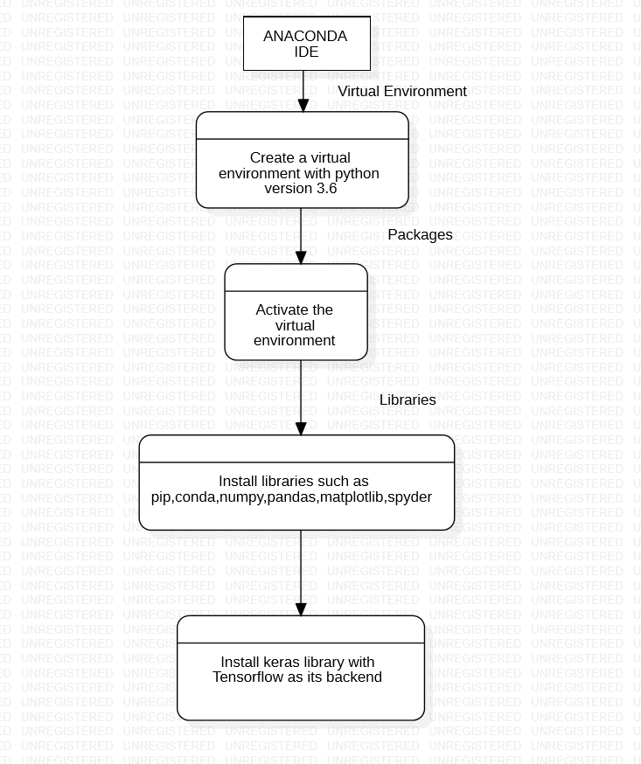

Slide 6
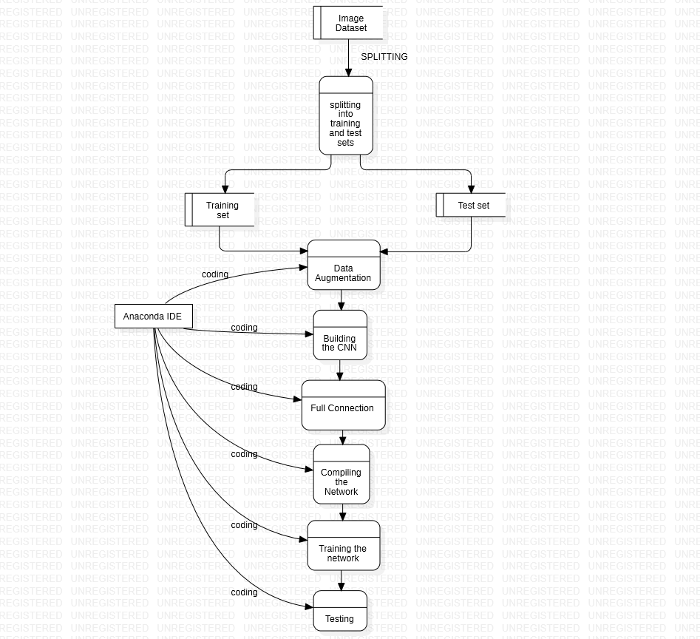

Slide 7
Data Flow Explanation:
Firstly, a virtual environment will be created using Anaconda command line interface and the virtual environment is activated.
In the next step, the libraries such as Numpy, Pandas, Matplotlib will be installed using conda command.
Tensorflow package is installed in the third step which is a necessary backend for Machine Learning models.
Keras is the last installation which is a library of neural networks and contains many classes and methods.
Datasets of flooded and non-flooded areas are collected from the Internet.
Using the Anaconda IDE, the coding is done to import datasets, train and test the model.

Slide 8
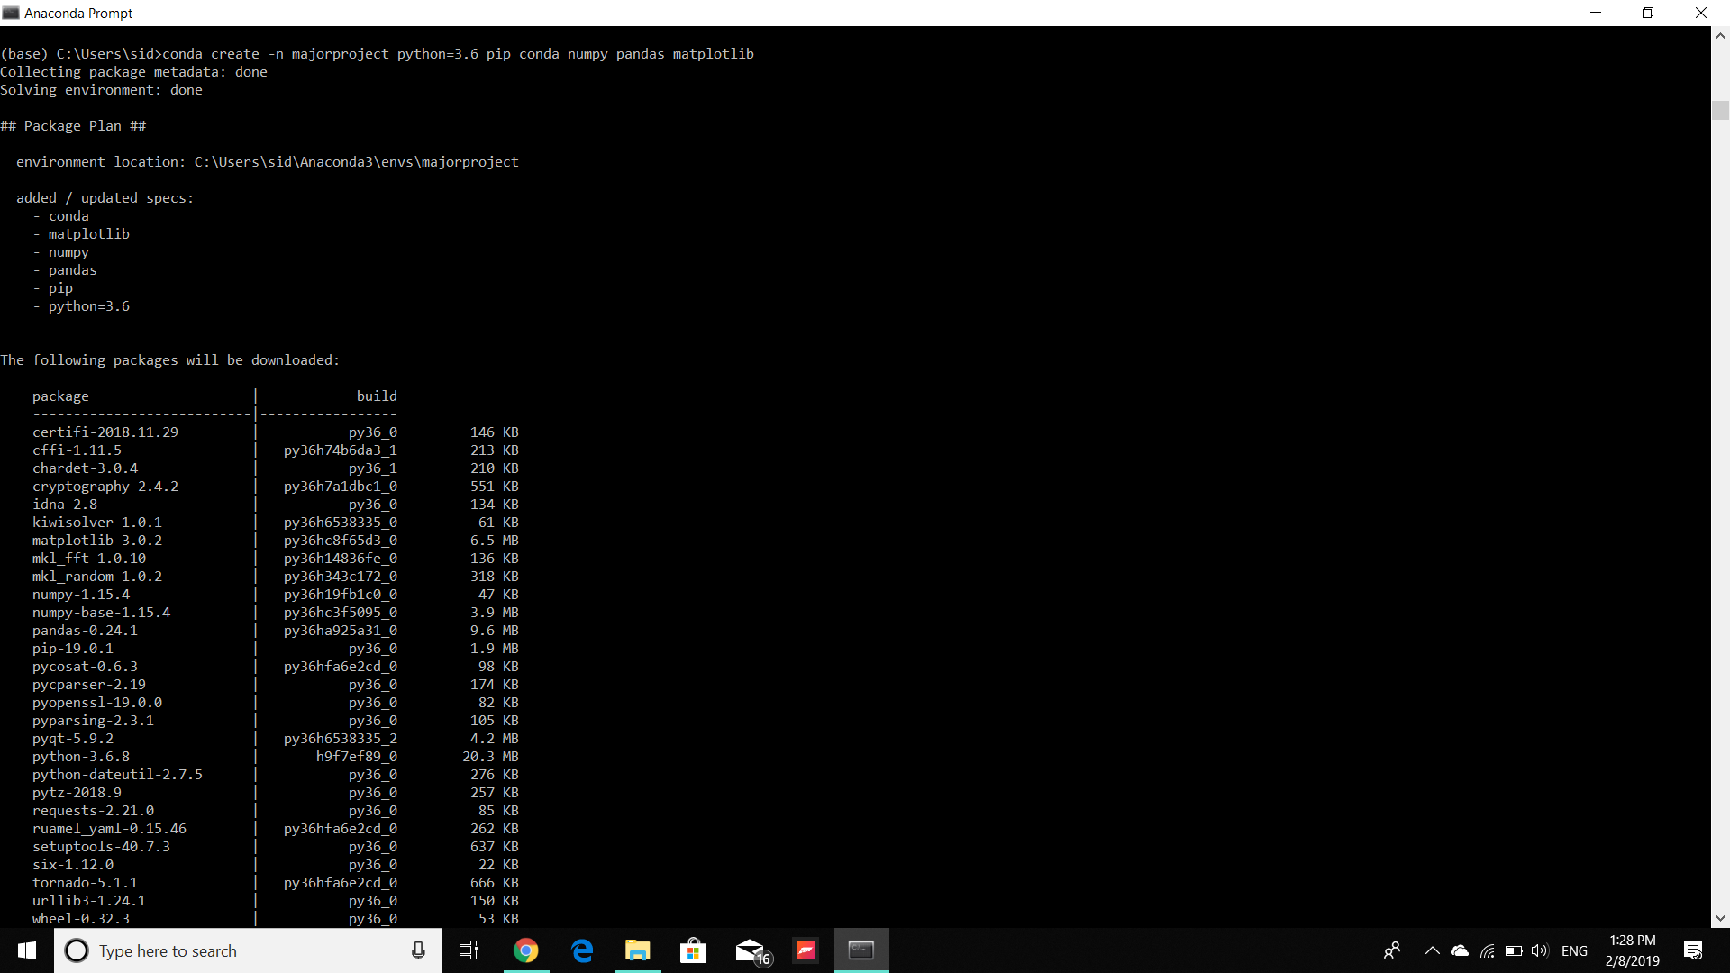

Slide 9


Slide 10
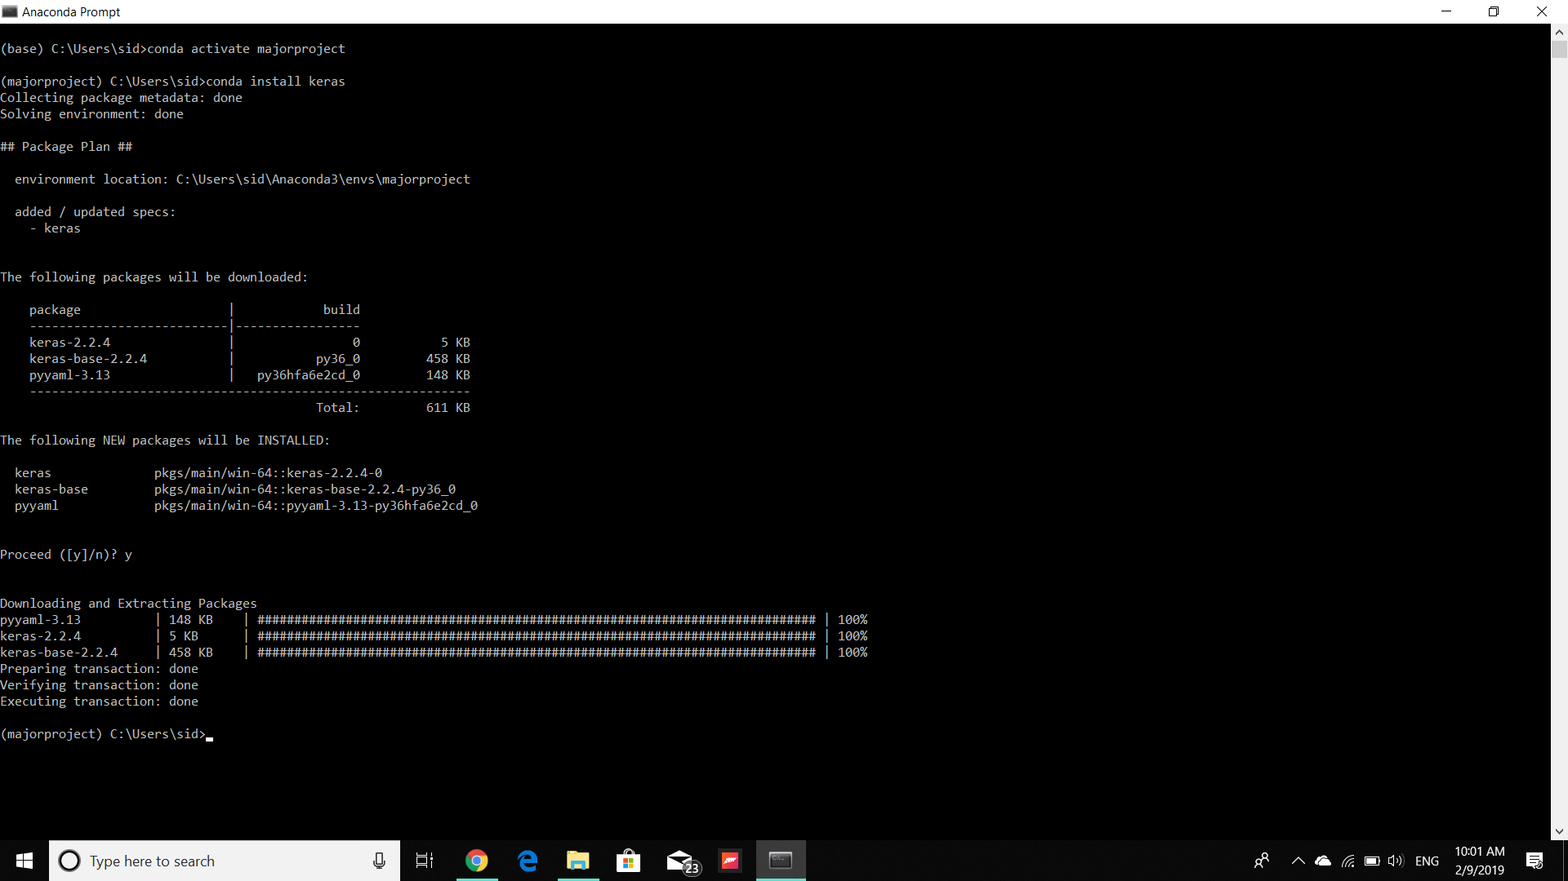

Slide 11
Implementation of the project:

Slide 12
Convolutional Neural Networks:
A convolutional neural network consists of an input and an output layer, as well as multiple hidden layers. The hidden layers of a CNN typically consist of convolutional layer, pooling layer, flattening layer, fully connected layer and loss layer.
The process of convolution in the convolutional neural networks is by cross-correlation.
Cross Correlation:
Cross-correlation is a measure of similarity between two series or features measured as a function.

Slide 13
Terms involved in Convolutional Neural Network:
Convolution:
Convolutional layers apply a convolution operation to the input, passing the result to the next layer.
Each convolutional neuron processes data only for its receptive field. Although fully connected feedforward neural networks can be used to learn features as well as classify data, it would require many resources and more energy would be required for processing. For instance, a fully connected layer for an image of size 100 x 100 has 10000 weights for each neuron in the second layer. The convolution operation brings a solution to this problem as it reduces the number of parameters, allowing the network to be deeper with fewer parameters.

Slide 14
Pooling:
In this layer, the outputs of neuron clusters at one layer are combined and passed onto a single neuron in the next layer.
Types of Pooling:
Maximum pooling
Average pooling
Receptive Field:
In a fully connected layer, each neuron receives input from every element of the previous layer. In a convolutional layer, neurons receive input from only a restricted subarea of the previous layer. So, in a fully connected layer, the receptive field is the entire previous layer. In a convolutional layer, the receptive area is smaller than the entire previous layer.

Slide 15
Weights:
Each neuron in a neural network computes an output value by applying some function to the input values coming from the receptive field in the previous layer. The function that is applied to the input values is specified by a vector of weights. Learning in a neural network progresses by making incremental adjustments to the weights. The vector of weights is called a filter. A distinguishing feature of CNNs is that many neurons share the same filter. This reduces memory footprint because a single vector of weights is used across all receptive fields sharing that filter, rather than each receptive field having its own vector of weights.

Slide 16
Activation Function:
Activation functions are used to bring non-linear properties to the network.
Generally, without an activation function, the output would be a linear function. The drawback with linear function is that it is not curvilinear and thus reduces accuracy of the network. The linear function has less power to learn from the network.
Whereas, activation functions introduce non-linear properties to the output of each layer and increase the learning power of the layers in the network.
Different activations functions are present such as the sigmoid function, ReLu function and Softmax function.

Slide 17
Thank You

Slide 18
Questions ?

